Slide 1
Step wise guidelines to convert a article manuscript into journal template format

Slide 2
Open your final prepared manuscript in word

Slide 3
Check all references are cited according to journal format (details provided on Author Guidelines section)
Cited as superscript continuous numbered
References formatted according to journal style (details provided on author guidelines section on journal site)

Slide 4
Now go to Author Guidelines section of the journal site of which template format you want to convert your article
And Click on the one of the article template link
Click on template link (left button click)
In the pop up window, select Open with (Word) and click OK
Alternatively, if have saved the file on your computer (using right click and save as..), then just left click on the file to open it

Slide 5
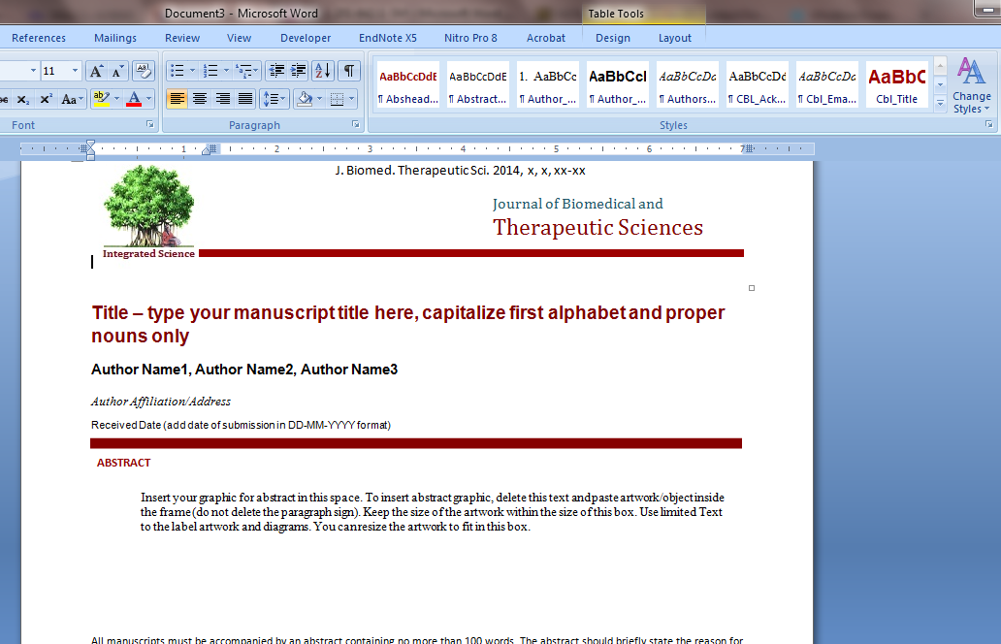
On clicking OK, a file will be downloaded and will open as new word document having predefined styles
New word document
Styles bar having predefined styles for article template

Slide 6
Now go to your manuscript file, select and copy the title
Select and copy title
Now switch to template file and paste this text at place of title text
Paste the copied title text

Slide 7
Now pasted text may not format according to defined style, just place the cursor on text and click on title style on style bar
Keep cursor anywhere on text
And click on Title style on style bar
On click, style of text will be formatted automatically.
Delete extra text

Slide 8
Now repeat this copy pasting for Authors, Affiliations, abstract and keywords. If text style is not formatted according to predefined style, then select the respective style from style bar to format the text of respective field.
Formatted style for respective field

Slide 9
Now copy the text of whole of manuscript (except figure and tables) and paste at the place of article text
As usual, the text may not format according to template format
Keep the cursor at beginning of paragraph and click on ‘Main Text’ on style bar
The text will be formatted according to template format.
Repeat this for all paragraphs to get formatted text

Slide 10
Now when text is formatted completely, then next step is insertion of figures and tables
STEP 1
place the cursor (pointer) where you want to insert the figure.

Slide 11
Step 2. Now at this point, insert a line (simply press ‘Enter’ key)

Slide 12
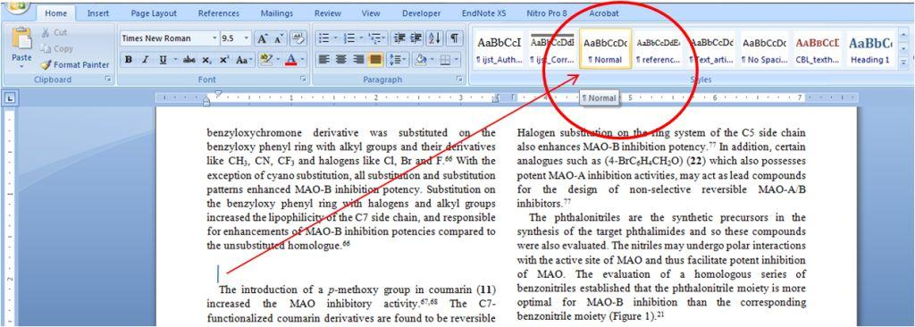
Step 3. Bring the text pointer (the blinking pointer when you write) to this line and select ‘Normal’ style (from style menu) for this inserted line as shown below

Slide 13
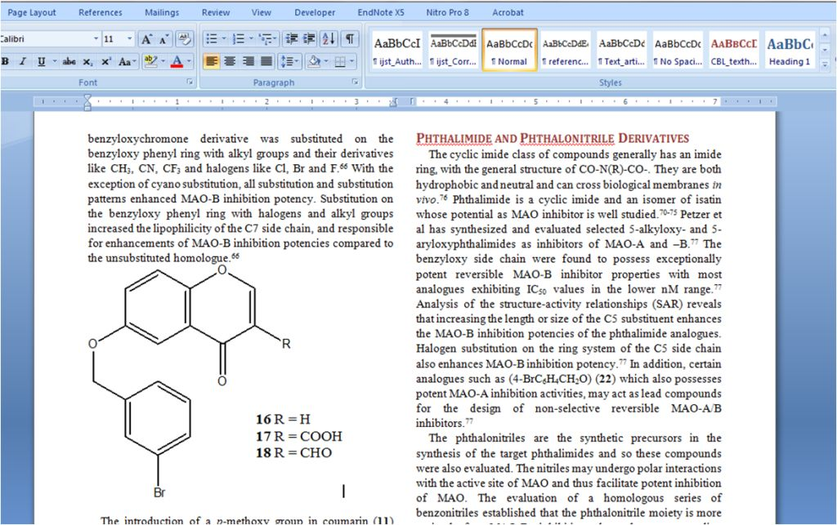
Step 4. Now go to the program from which you want to insert figure (resize the figure in its program itself so that it fit into one column). Now copy (ctrl+C) the figure. Come to word file and paste (ctrl+V) at the point of insertion.

Slide 14
Step 5. Now insert one line break (press ‘Enter’ ) after the inserted figure and write caption for figure (set its style to Times New Roman, 10 point).
You can use same procedure for insertion of more figure or insertion of any other graphics including images, tables, chemical structures.

